Slide 1
Adversarial Machine Learning in Cybersecurity
Jesús Alejandro Noguera Ballén
Research Seminar 2018 – II
Universidad Nacional de Colombia
Notes:
NOTASSS

Slide 2
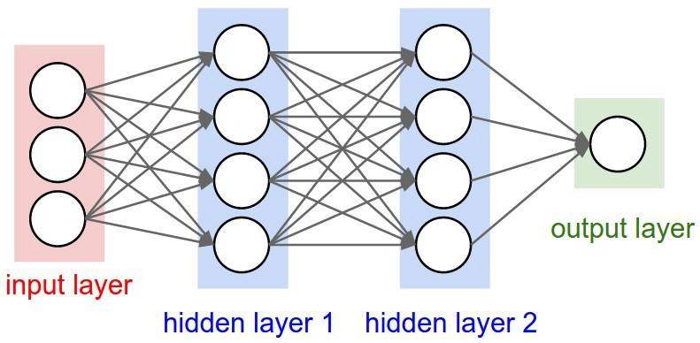
Summary – State of the Art
Machine learning fields.
Some errors in some algorithms.
The adversarial attacks.
Neural Network
Notes:
Prueba de notas

Slide 3
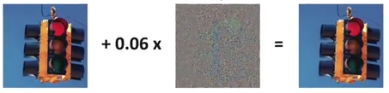
Problem
A correct adversarial Attack.
Perturbation
Miss Classification
Notes:
Estas son notas en la segunda página

Slide 4
Goals – Research Goals (how solve the problem)
Improve robustness classification:
Image transformations

Slide 5
References
1
Xiao, H. (2017). Adversarial and Secure Machine Learning, 153. Retrieved from https://mediatum.ub.tum.de/1335448.
2
Kurakin, A., Goodfellow, I., & Bengio, S. (2016). Adversarial examples in the physical world, http://arxiv.org/abs/1607.02533. Journal Article, 1-14.
3
Goodfellow, I. (2016). Practical Black-Box Attacks against Deep Learning Systems using Adversarial Examples Practical Black-Box Attacks against Deep Learning Systems, (November). http://arxiv.org/abs/1602.02697.
4
Sinha, A., & Krishnamurthy, B. Understanding Adversarial Space through the lens of Attribution. http://www.research.ibm.com/labs/ireland/nemesis2018/pdf/paper4.pdf
5
Hayes, J., & Danezis, G. (2017). Learning Universal Adversarial Perturbations with Generative Models. https://doi.org/10.1109/SPW.2018.00015.
6
NIPS 2017 (2017) - Adversarial Learning – Adversarial attacks and defenses. https://github.com/anlthms/nips-2017.

